Slide 1
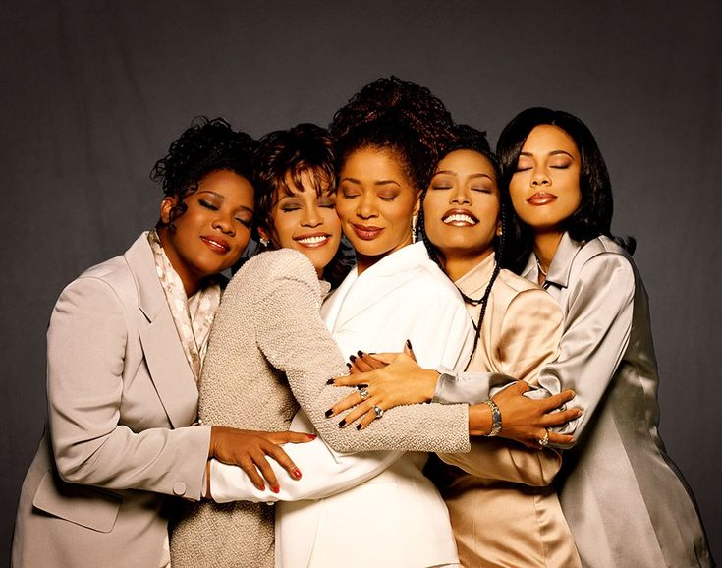
Changing the Narrative on Suicide
A conversation on mental awareness, compassion, and hope among women in their 50s and 60s.
Presentation by Joy Gacheri, Psychologist.

Slide 2

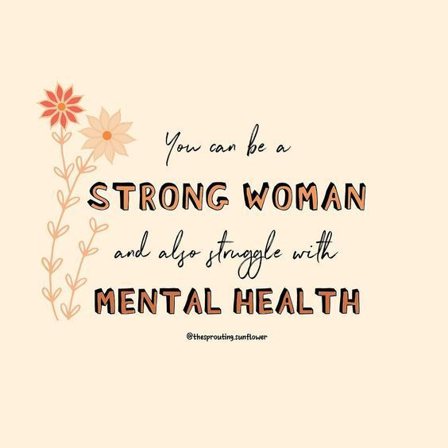

Slide 3
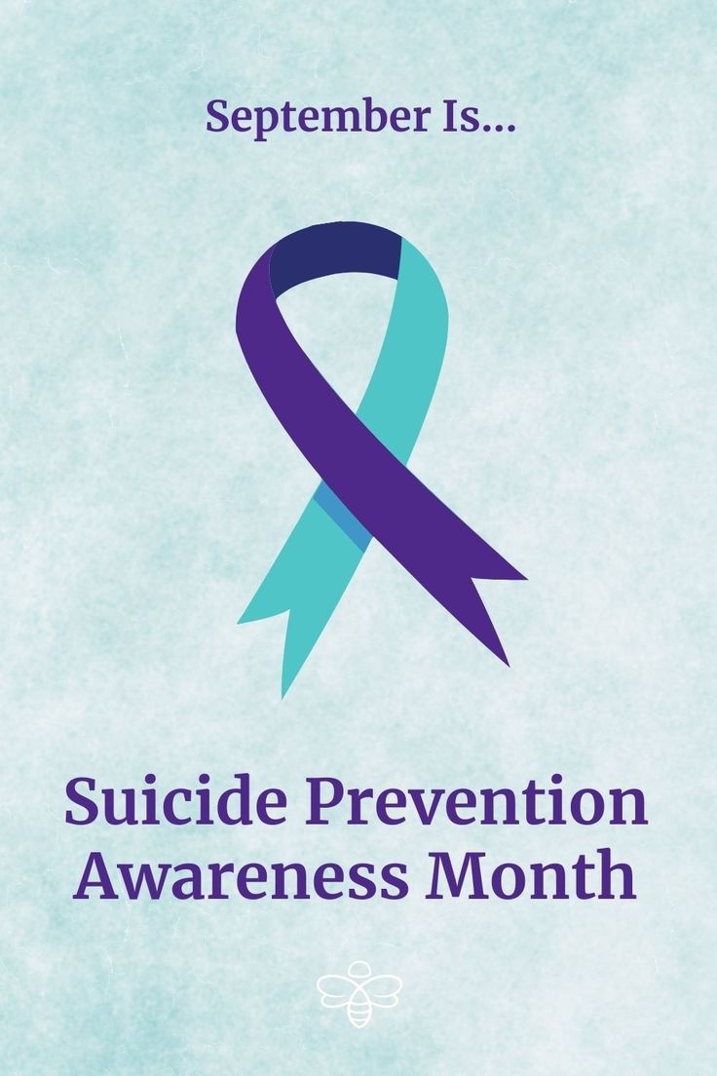
Suicide Prevention Awareness
This year’s theme as we celebrated Suicide Prevention Day on 10th September was “Changing the Narrative on Suicide.”
Changing the Narrative
means shifting from silence, shame, and judgment to open dialogue, compassion, and support.
🌍 Importance of Commemorating Suicide Day:
Raises awareness. It reminds us that suicide is a public health issue we can prevent.
Breaks stigma by opening doors for honest conversations about mental health.
Educates communities by teaching people to recognize warning signs and respond with care.
Promotes action by encouraging families, leaders, and health systems to step up.

Slide 4
What is Suicide?
According to WHO, suicide is a serious public health problem with multi-faceted causes, influenced by social, cultural, biological, psychological, and environmental factors present throughout a person’s life.
💡It is a deeply painful act, born out of suffering, despair, and a sense of isolation.
💡It is the outcome of unaddressed emotional, psychological, social, and often spiritual anguish, where hope feels out of reach and the burden of life becomes overwhelming.
💡It is not a failure or weakness, but rather, a signal that someone, especially those who are long seen as resilient (such as women over 50), are crying for compassion, understanding, and support

Slide 5
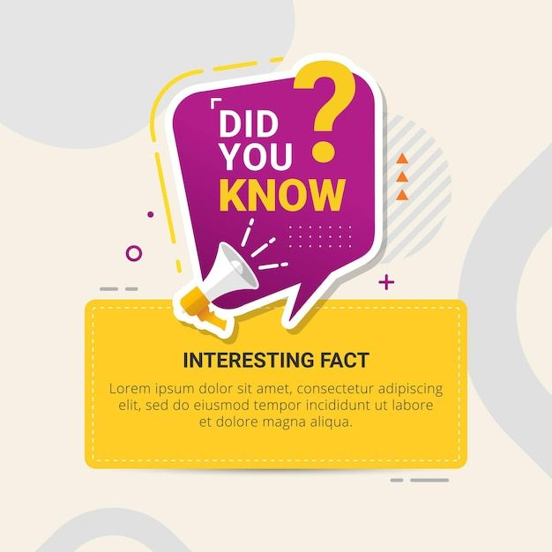
In Kenya, attempting suicide was decriminalized on 9th January 2025 and is no longer seen as a crime.

Slide 6
What do the numbers say?
Globally,
Around 700,000–727,000 people die by suicide each year worldwide (WHO, 2021).
Suicide is the third leading cause of death among young people (15–29 years).
75% of suicides occur in low- and middle-income countries (like Kenya).
For every 1 suicide, there are about 20 attempts.
In Kenya,
Every day, about 4 Kenyans die by suicide. That’s thousands of lives lost each year. On average, this means 6–11 deaths for every 100,000 people in the country.
Men are most affected → 8 out of every 10 deaths are male. Women attempt suicide more often, but fewer die compared to men.
Counties with high rates: Places like Kakamega, Kisii, and Meru have been flagged in police and hospital reports as counties where suicide cases are rising.
Nairobi: In just the first 3 months of 2023, 24 people died by suicide. Of these, 19 were men and 3 were women (2 not identified). This shows that even in the city, even with hospitals, churches, and support systems, people are still suffering in silence.
Changing the narrative means we stop thinking suicide only happens far away in villages or only to men. It affects all our communities: rural and urban, men and women, including women over 50 who are often unseen in the numbers

Slide 7
Risk factors:
Health challenges – chronic illnesses (e.g., hypertension, diabetes, arthritis), menopause changes, or untreated mental health conditions (like depression, bipolar, or anxiety).
Economic strain – retirement pressure, unemployment, lack of financial independence if she relied on spouse/children.
Family responsibilities – caregiver burden for elderly parents, adult children still dependent, or raising grandchildren.
Marital/relationship struggles – widowhood, separation, emotional neglect, or domestic conflict.
Cultural stigma – silence around mental health, pressure to “stay strong,” discouragement from seeking help.
Social isolation – children moving away, feeling “left behind,” limited peer networks.
History of trauma – gender-based violence, unhealed grief, childhood adversity.
Substance use – rising alcohol use among women as coping.

Slide 8

Warning signs:
Withdrawal from community life – skipping church, chamas, family gatherings.
Loss of interest – no longer enjoying farming, cooking, or activities she once loved.
Changes in mood – persistent sadness, irritability, sudden calm after agitation.
Talking about hopelessness – saying things like “life has no meaning anymore” or “my children are better off without me.”
Changes in routine – neglecting personal hygiene, not preparing meals, sleeping too much or too little.
Giving away possessions – jewelry, heirlooms, or treasured household items.
Increased reliance on alcohol or medication.
Seeking access to means – talking about pesticides, medication, or other methods.

Slide 9

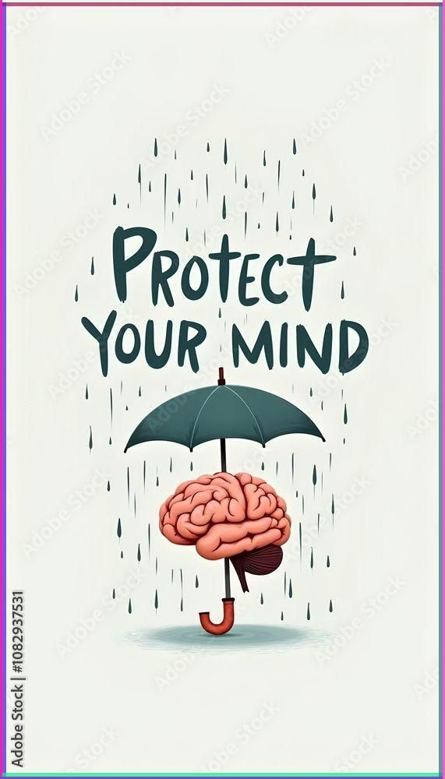
Changing the Narrative.
SBB:
Spot the Signs → Learn and share the warning signs of suicide. noticing can save a life.
Break the Stigma → Talk about suicide openly, with compassion, not whispers.
Bridge the Gap → Support access to care: encourage professional help, community circles, and faith-based resources.

Slide 10
