Slide 1

Dignity preserved to the end

Slide 2

KEY FACTS
DEMENTIA DEFINITION
Dementia is a syndrome –usually a chronic or progressive nature that leads to deterioration in cognitive function (the ability to process thought) with the most common type being Alzheimer’s disease.
Dementia affects memory, thinking, behavior, emotions, language, learning capacity, judgment, calculation and comprehension.
It affects all groups in society and is not linked with social class, gender, ethnic group or geographical location.
Dementia is the 7th leading cause of death globally.
According to Dementia (who.int) Currently more than 55 million people live with dementia worldwide ,and there are nearly 10 million new cases every year.
Early detection of dementia can lead to better health outcomes.
N/B Although dementia mainly affects older people; it is not an inevitable consequence of ageing.

Slide 3
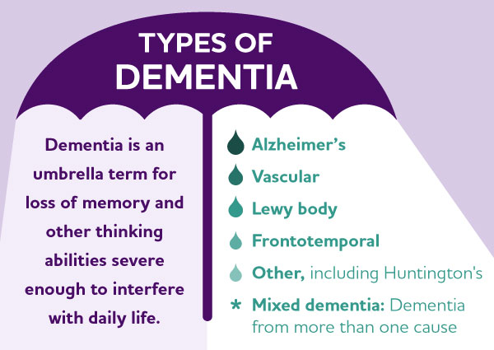

Slide 4
EARLY STAGE (Mild)
Memory lapses (especially recent events)
Difficulty finding words or remembering names
Trouble with planning or organizing
Misplacing items more frequently
Becoming withdrawn or experiencing mood changes
Still able to function independently with minor support

Slide 5
MIDDLE STAGE (Moderate)
Difficulty with daily tasks (e.g., cooking, managing finances)
Problems recognizing familiar people or places
Changes in sleep patterns
Wandering or getting lost
Repetitive speech or behaviors
Needing more assistance with personal care

Slide 6
LATE STAGE (Severe/End Stage)
Inability to communicate clearly
Significant memory loss, even of close family
Loss of mobility or trouble walking
Difficulty swallowing and eating
Incontinence
Full dependence on others for care
Vulnerability to infections (e.g., pneumonia)

Slide 7
RISK FACTORS
MODIFIABLE RISK FACTORS
Obesity
High blood pressure
Smoking
Diabetes
Depression
Physical inactivity
Binge drinking
Hearing impairment
Air pollution
Less education
Head injury
Infrequent social contact
Z

Slide 8
NON-MODIFIABLE RISK FACTORS
Age
Genetic make up

Slide 9
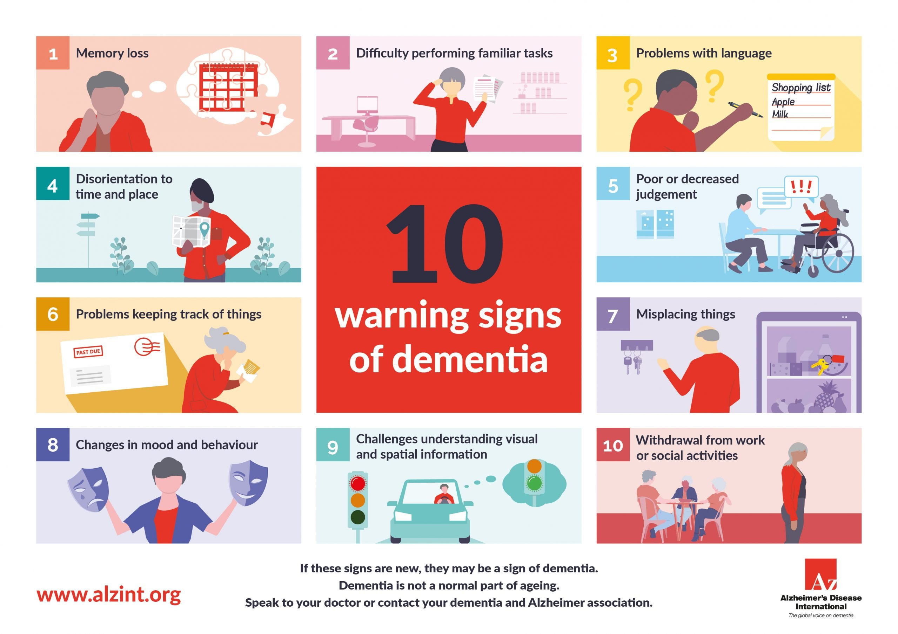

Slide 10
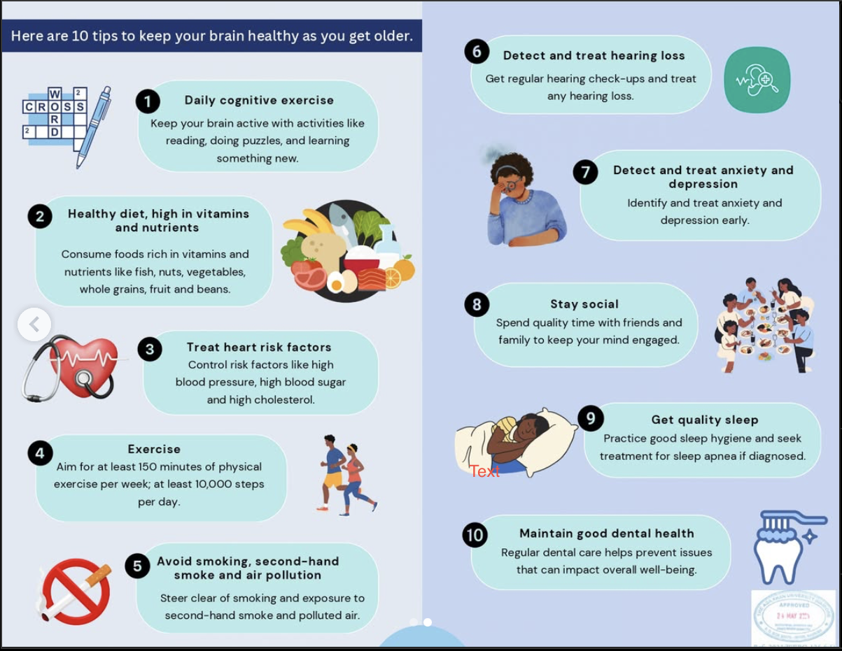

Slide 11
MYTHS AND FACTS OF DEMENTIA
MYTHS
Dementia is inevitable with age
People living with dementia are cursed or, practice witchcraft
Dementia is not preventable
A person with dementia is a gone case and nothing can be done
People with dementia are confused and really can’t understand anything
FACTS
Dementia is not a normal part of ageing
People do not get dementia as a consequence of their actions ,but rather due to complications in the brain.
Research suggests that with proper diet, regular exercise and and reduced intake of alcohol may help prevent chances of developing dementia
Many people with a dementia diagnosis lead active lives.
The person can fully understand (his /her history ,likes and dislikes.

Slide 12
MYTHS AND FACTS OF DEMENTIA
MYTHS
Using aluminum pans cause Alzheimer's
Memory loss always signifies dementia.
Dementia and Alzheimer's disease are the same thing
FACTS
Scientists have not found a clear association between Alzheimer's and using aluminum pots
Although memory loss is an early symptom of dementia , it does not necessarily signify the start of this condition.
Alzheimer's is a type of dementia.

Slide 13
DIAGNOSIS AND TREATMENT
There is currently no treatment available to cure dementia. However much can be offered to support and improve lives of people living with dementia and their caregivers.
The principal goals for dementia care are:
  Early diagnosis in order to promote early and optimal management
  Optimizing physical health, cognition, activity and well being
  Understanding and managing behavior changes
  Providing information and long-term support to care givers.

Slide 14
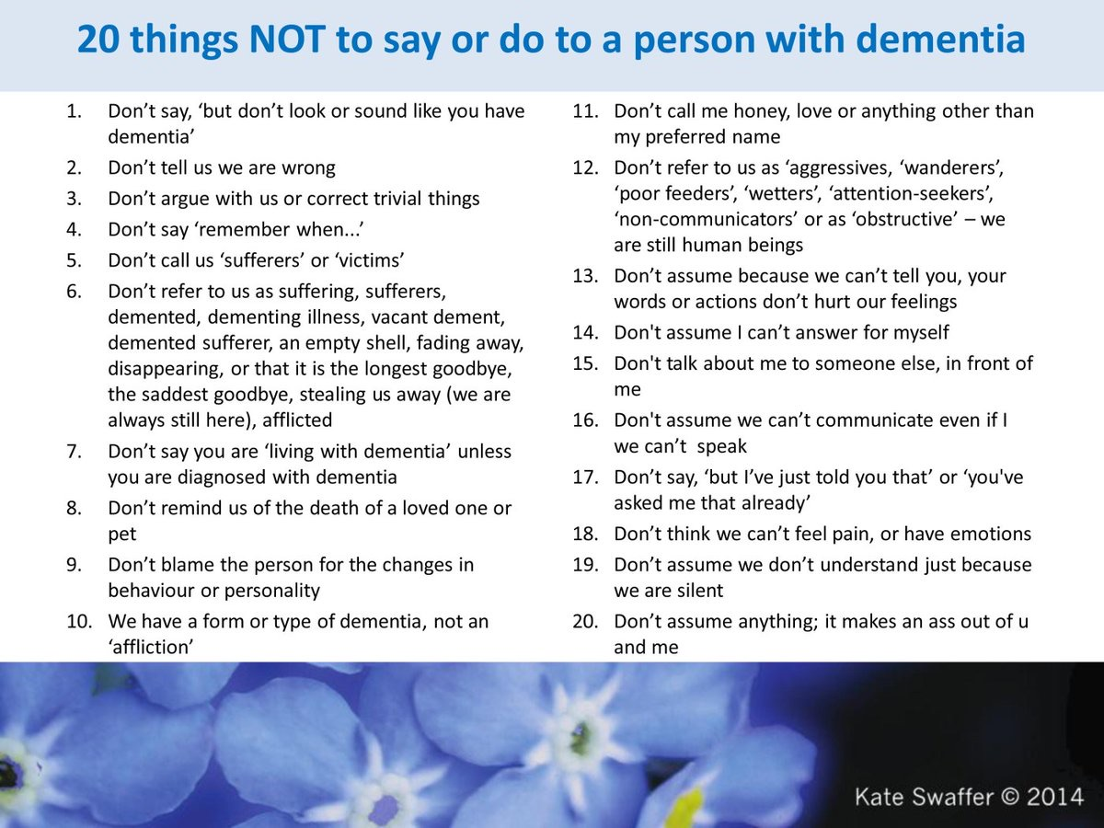
DEMENTIA CARE TIPS

Slide 15
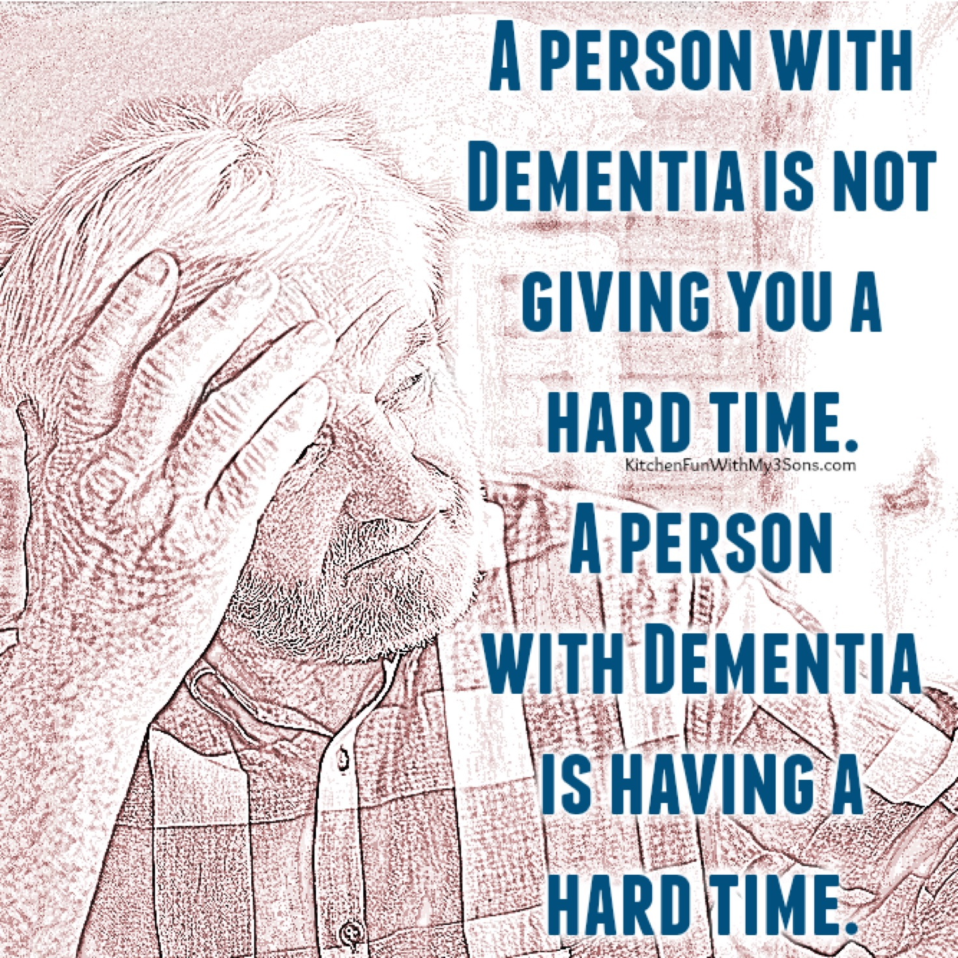

Slide 16
REFERENCES
World Health Organization (WHO)
Alzheimer's and Dementia Organisation in Kenya
Alzheimer's Association
Alzheimer's Disease International (ADI)

